Slide 1

Prepared by group 2
Natural language processing with disaster tweets
24 February, 2025
Jayesh Chaudhari
Kratika Jain

Slide 2


Team Members
Kratika Jain
Jayesh Chaudhari
Member
Member

Slide 3



Project Overview
The goal is to classify tweets as disaster-related or not.
We explore multiple NLP-based models.
Compare traditional ML vs deep learning approaches.

Slide 4

Why does this problem matter?
The Problem:
In disaster situations, social media is often the first source of real-time information.
Identifying real disaster-related tweets from general noise is challenging.
Misinformation and irrelevant tweets can slow down response efforts.

Slide 5
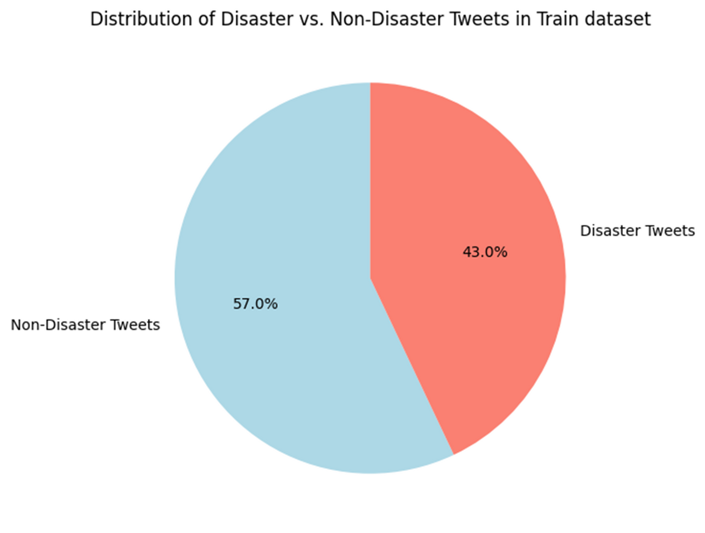
Exploratory Data Analysis
Not a severe class imbalance

Slide 6
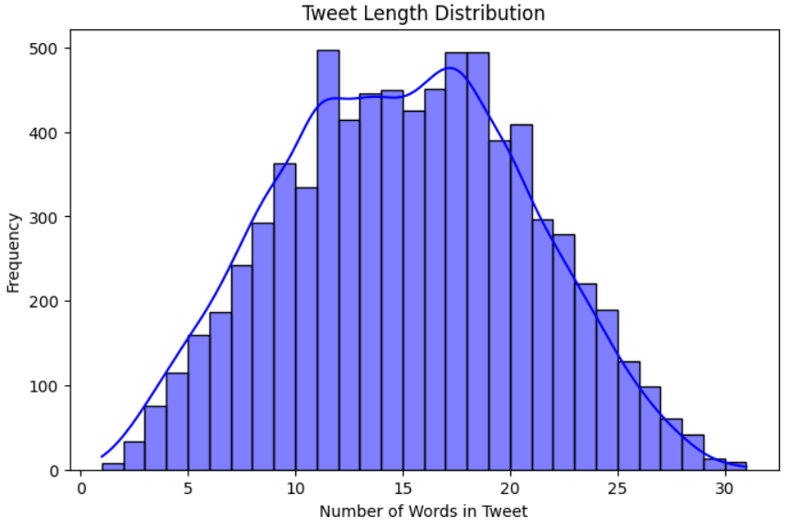
Exploratory Data Analysis
Tweets range from 5 to 30 words, with most tweets averaging around 15 words.
The distribution follows a normal-like pattern, with a peak between 10–20 words.

Slide 7
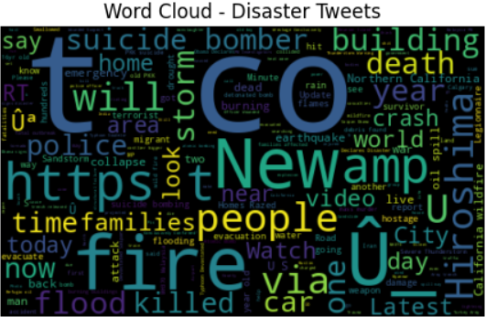

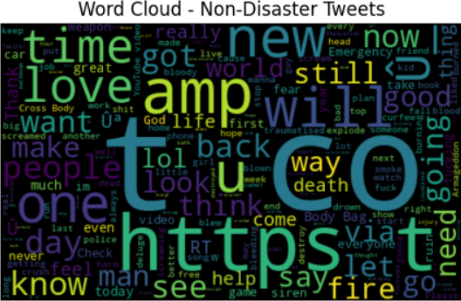
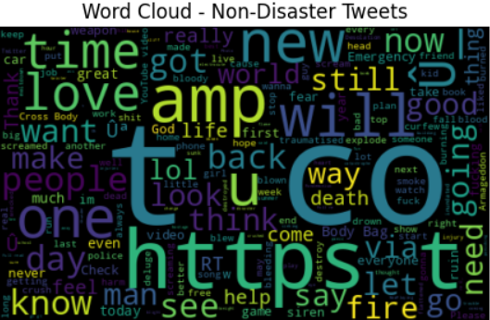
Exploratory Data Analysis
Word Frequency Patterns:
Tweets: Common words: fire, flood, killed, storm, death, families, police.
Non-Disaster Tweets: Common words: love, good, people, new, want, day, think.

Slide 8

Preprocessing Steps
Text Cleaning
Lowercasing
Removing URLs, punctuation, and special characters
Feature Extraction
Stop word removal
Stemming
Tokenization
Vectorization

Slide 9



Modeling Approaches
Traditional Machine Learning Models
Deep Learning Models
Model Evaluation
LSTM, BiLSTM
Transformer-based (DistilBERT, BERT )
Accuracy
Precision, Recall
F1 score
Logistic Regression
Random Forest
SVM

Slide 10

Model Performance Comparison
Multinomial Naive Bayes
Validation Accuracy: 79.45%
Test Accuracy: 79.25%
DistilBERT
Validation Accuracy: 83.78%
Test Accuracy: 82%
BERT
Validation Accuracy: 83%
Test Accuracy: 83.328%

Slide 11
Model Performance Comparison
Gradient Boosting
Validation Accuracy: 99%
Test Accuracy: 79.80%
DistilBERT - Fine tuned
Validation Accuracy: 83.78.%
Test Accuracy: 82%
Random Forest Classifier
Validation Accuracy: 78.53%
Test Accuracy: 79.252%

Slide 12

Best Model Selection
Model | Test Accuracy | Validation Accuracy | Precision | Recall | F1-Score
BERT | 83.328% | 83% | 83% | 83% | 83%
DistilBERT | 82% | 81.75% | 84% | 84% | 84%
Multinomial Naive Bayes | 79.252% | 79.45% | 80% | 79% | 79%
Random Forest Classifier | 79.252% | 78.53% | 79% | 79% | 78%

Slide 13

Challenges Faced
Data Preprocessing Challenges
Noisy data
Text Length Variability
Model Performance Trade-offs
BERT achieved high accuracy (83.45%) but took ~60 minutes to train
XGBoost trained in just 3 minutes but had slightly lower accuracy (79.8%).
DistilBERT offered a balance (82% accuracy, ~15 min training time)
Evaluation and Metrics Challenges
For XGBoost AUC-ROC (0.85) vs. F1-score (0.99) which is a clear case of overfitting

Slide 14
Key Takeaways
BERT-based models provide superior accuracy but require significant computational resources.
XGBoost is a strong alternative when speed and interpretability are priorities.
DistilBERT offers a balanced approach, achieving competitive accuracy with reduced training time.
Preprocessing and feature engineering play a critical role in improving model performance.
Choosing the right evaluation metric (F1-score vs. AUC-ROC) is crucial depending on the dataset balance.

Slide 15
Thank you
Any Questions?

